Slide 1
Social Networking & Employment Law
Bonnie C. Jones, M.A.Ed.
Human Resources Consultant
Josh D. Jones
Attorney
University of Tennessee, MTAS
Notes:
Googling and Twittering are now verbs?

Slide 2
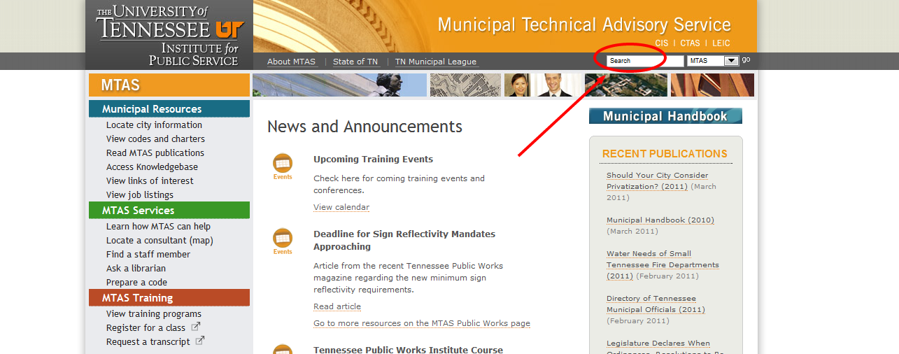
MTAS Publication Available Electronically
www.mtas.tennessee.edu
Enter Social Media in search bar

Slide 3
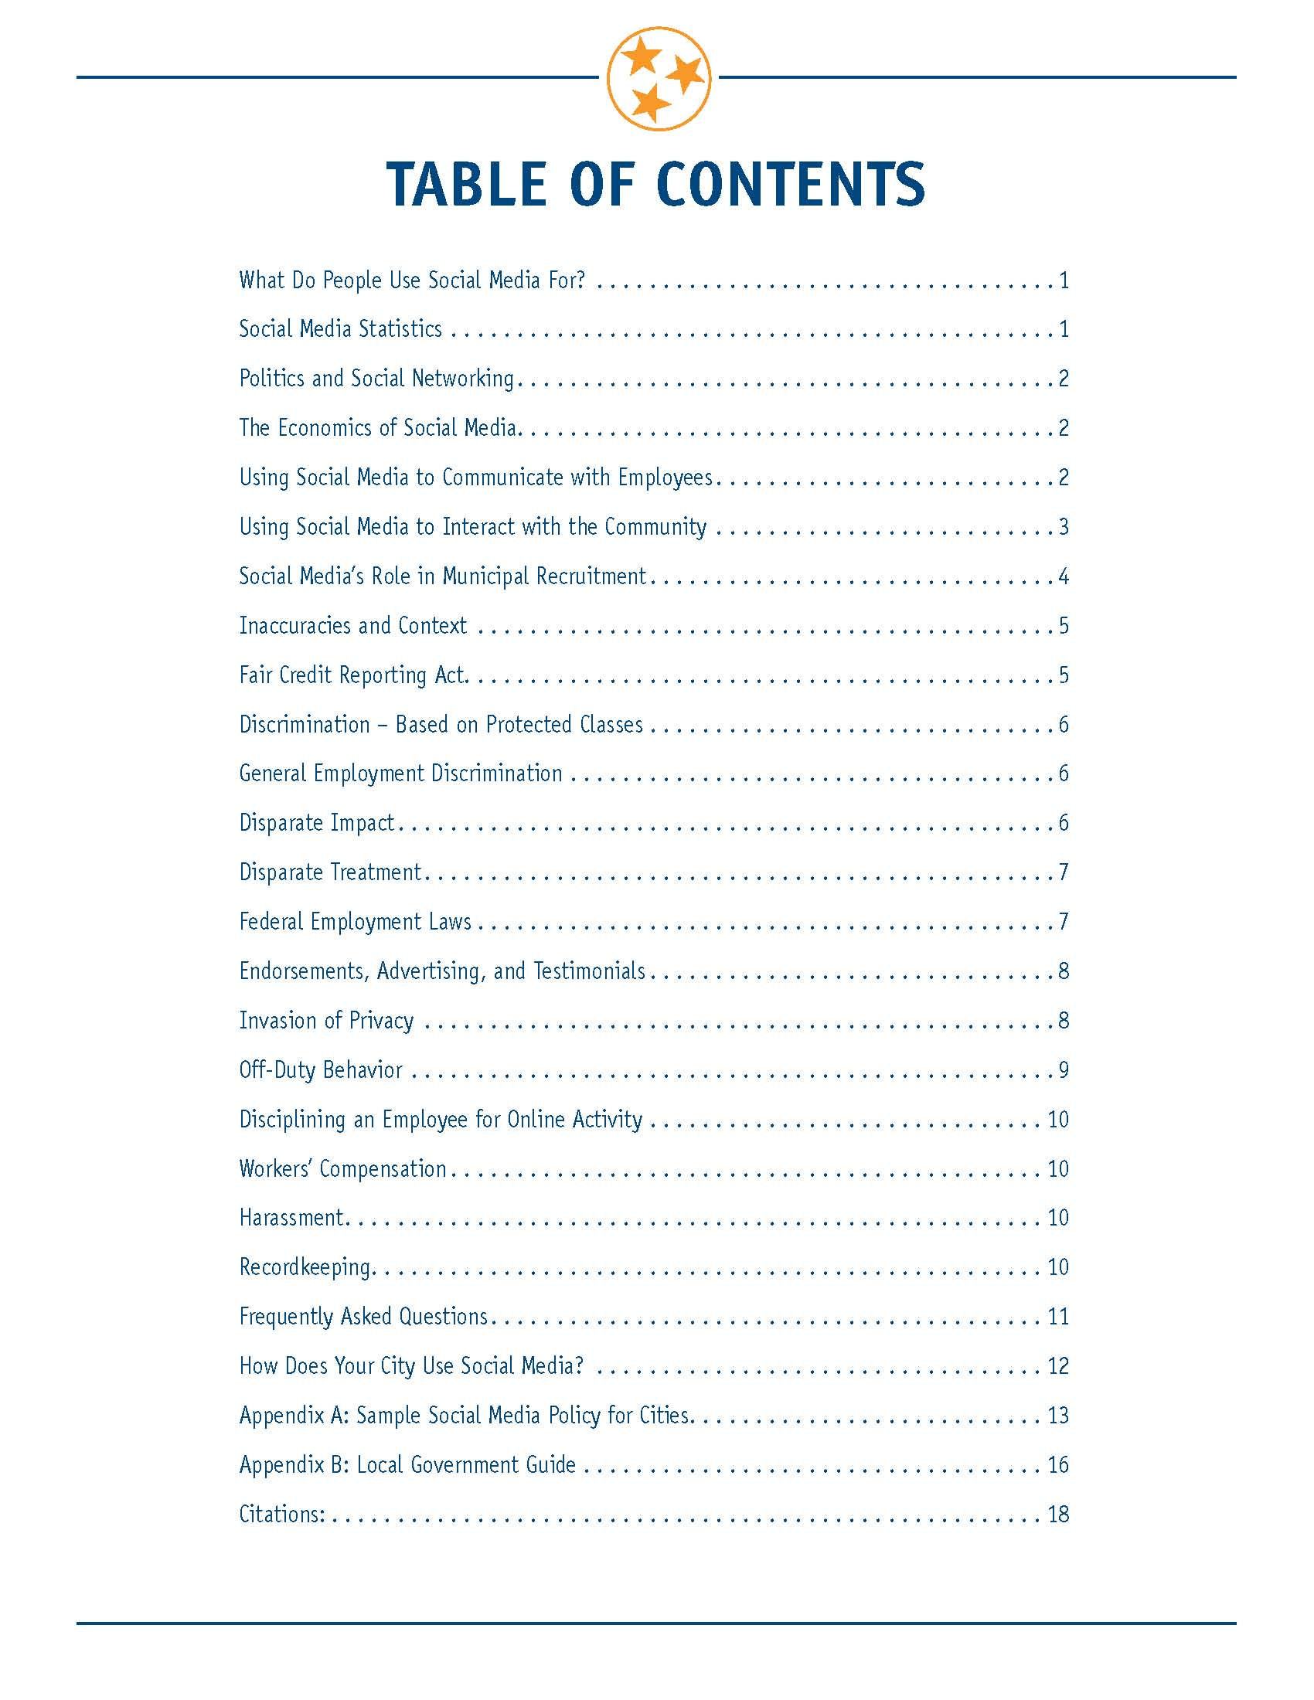


Slide 4

What is social media?
It is an umbrella term used to describe interactive communication via the web using various applications
Notes:
Social media includes the various online technology tools that enable people to communicate easily via the internet to share information and resources. Social media can include text, audio, video, images, podcasts, and other multimedia communications.
GreenmarketingTV says as most of you know, social media was an outcome of the highly-connected world of web 2.0 apps, social platforms and interactive based marketing efforts. Social Media became a buzzword only a few years ago, but it has existed in one form or another for many years before that. In a crux, social mediadefines the essence of online networking.
Many say it is the 4th phase of the industrial revolution OR the next revolution.

Slide 5
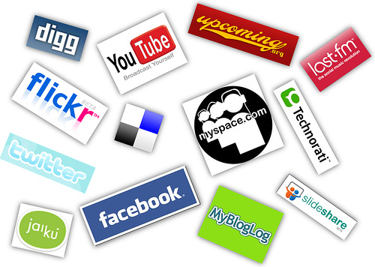
People generally use social media for:
Networking
Socializing
Marketing
Notes:
Social Networking has 3 primary roles:
Networking: business or personal
Socializing- business or personal
Marketing- Business profiles are huge! Online promo codes/ sales etc.

Slide 6
Municipalities use social media
To interact with community
To interact with employees
As an employment tool
The City of Boston’s award winning Citizen’s Connect
http://www.youtube.com/watch?v=iwZ5POX5hHM
Notes:
Perhaps the most effective use of social media as a means to communicate with citizens is in the area of roads, construction, and city projects. The city of Boston, Massachusetts created an award-winning, interactive smart phone application for citizens to report graffiti, potholes, broken streetlights, road problems, and other city issues to the city of Boston. The application is called Boston Citizens Connect and allows users to report problems anytime and without the expense of a municipal employee. Users can simply use their cell phones to snap a photo of any condition and send it to the city all in the span of a few seconds. When the picture is sent, the location’s coordinates are automatically embedded in the picture and the user can expound with typewritten details if necessary. After a complaint is made a red dot shows up in the application on a map that can be seen with a Smartphone. When the problem is fixed the dot changes to green and the citizen knows the problem has been resolved. While the technology is complex, for the user it only requires the touch of just a few buttons on a smart phone.

Slide 7
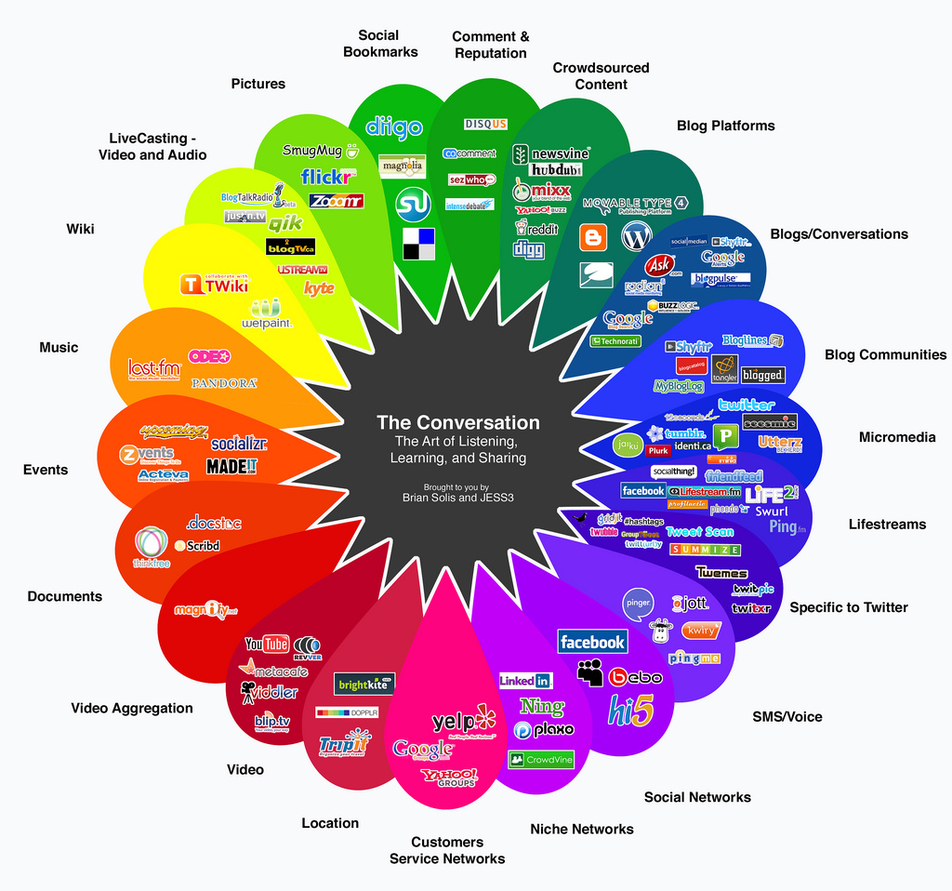
The social media wheel
Notes:
This graphic shoes what social media outlets cater to different communities and user needs
What you might use for Photos may be different than where you go for blogs etc.

Slide 8
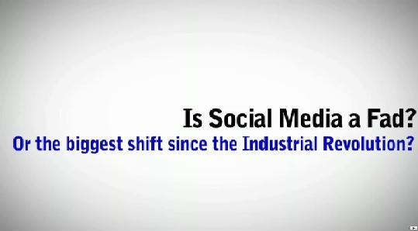
Is Social Media a Revolution?
http://www.youtube.com/watch?v=QzZyUaQvpdc
Notes:
Many say that social media is akin to the industrial revolution
Social Media Revolution 2 is a refresh of the original video with new and updated social media & mobile statistics that are hard to ignore. Based on the book Socialnomics by Erik Qualman.

Slide 9

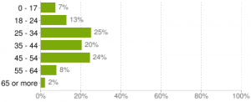
Facebook
590 million users
Reaches 57% of people in the USA
Reaches 35% of people worldwide
More than 57% of users are women
24% of users are age 45-54
Notes:
Facebook has about 65M visitors per day (3rd Quarter 2010) USA Today has a circulation of only 1.8 million compared to Facebook’s over 65 million visitors (based on cookies.)
Note, the second largest use is among adults aged 45-54, almost tied with 25-34!!! (3rd Quarter 2010)
What political party uses social media the most?
Republican congress members may have a big advantage in the run-up to the midterm elections. A full 72% of Congressional Republicans have at least one Twitter account, compared to 55% of Congressional Democrats, according to study released today by communications firm Burson-Marsteller.
Republicans also had 38% more followers on their congressional accounts, where they tweeted about legislation.
Republicans had almost double the followers for campaign-specific accounts
http://www.readwriteweb.com/archives/republicans_in_congress_are_more_active_and_more_p.php?utm_source=feedburner&utm_medium=feed&utm_campaign=Feed:+readwriteweb+(ReadWriteWeb)
3rd Quarter 2010
One statistic that keeps bouncing around in the Social Media world is that “women over 55 is the fastest growing group of Facebook users.” That it is old data. While the over 55 group had climbed to 16% at the end of March 2010, it is now the fastest shrinking age group and Facebook users under 18 years old have been the fastest growing group during the last six months.
Statistics by Paul Kiser (3rd Quarter 2010)
http://paulkiser.wordpress.com/2010/10/08/3q-social-media-stats-update/
March 2011: Social networking site usage grew 88 percent among Internet users aged 55-64 between April 2009 and May 2010 (Pew Research)

Slide 10
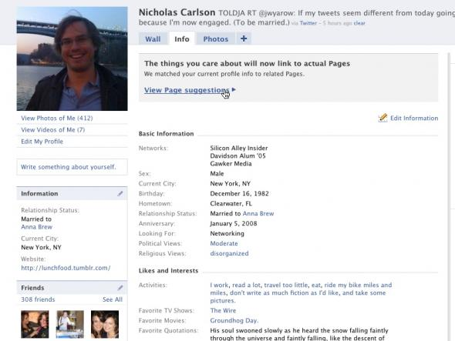
Sample Facebook profile
Notes:
Often times groups / friends that you are associated with provide information about disability status, veteran status, religious affiliation, and ethnicity.
Originally designed for college students as a social networking Web site, Facebook allows each user to create a profile, complete with information such as home address, mobile phone number, interests, religious views, and even the requisite data for online dating like sex, relationship status, and sexual orientation. In addition to creating individual profiles, Facebook users can also designate other users as “friends,” send messages, and post pictures. Figure 1 presents a screenshot of a Facebook profile rendered in a Web browser. On Facebook, sexual orientation is denoted by a field labeled “Interested In” — (men, women, men and women, blank), although in this case it was intentionally omitted by the owner of the profile.

Slide 11

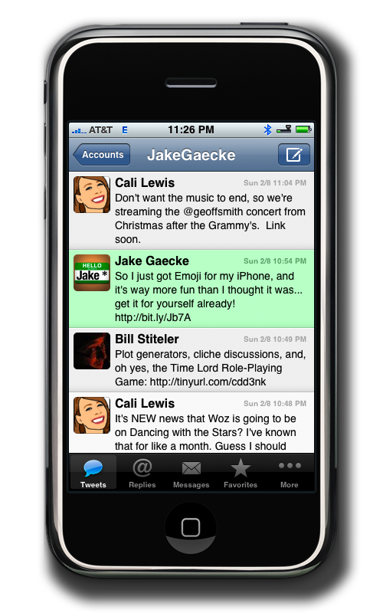
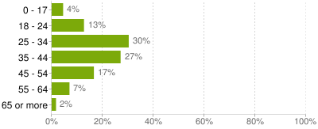
Twitter
165 million users (98M direct to site)
18-34 age group is up by 16%
35-64 age group is down by 9%
Most tweet through applications
Notes:
The impact of Twitter is not in the posts, but the conversations and the URL links to other blogs and webpages. Twitter is like Headline News for new ideas and concepts.
Twitter seems to have made a shift to younger adults. The 18-34 age group is up by 16%, while the 35-64 age group is down by 9% from six months ago. Also, teenagers (under 18) have dropped by 6% since the 1st quarter and now make up only 4% of all Twitter users. The apparent dislike for Twitter among teenagers is a clear age defining characteristic
Twitter membership is difficult to pinpoint. They are fairly tight lipped about their users activity. However, on Oct 4th, 2010 their CEO announced 165 MILLION USERS.
http://webcache.googleusercontent.com/search?q=cache:euQQ0A8zbsQJ:blog.twitter.com/2010/10/newtwitterceo.html+Oct+2010+How+many+users+does+Twitter+have%3F&cd=3&hl=en&ct=clnk&gl=us
3rd Quarter 2010 - http://paulkiser.wordpress.com/2010/10/08/3q-social-media-stats-update/
Difference is stats is cell phone applications.

Slide 12
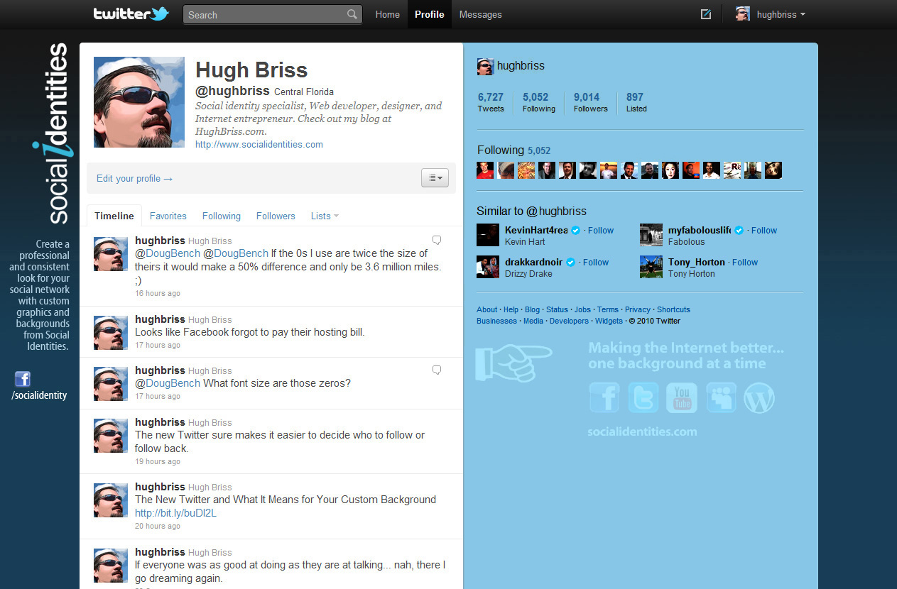
Sample Twitter Profile
Notes:
140 characters
Q: Is it Twittering or Tweeting?
A: Twittering
The founders call Twitter an Information network rather than a social network
Twitter- is a verb (the sounds that birds make)
Individual update is called a Tweet (tweeting is not proper, but accepted)
Twittering is the proper active verb

Slide 13

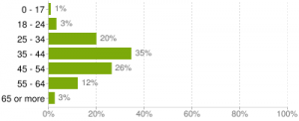
Linked-in
41 million users
Professional networking & recruiting site
Online Resume
Great for setting up professional groups
Notes:
Not as interactive, used to sell yourself (An online resume)
It will be interesting to see how LinkedIn will fare as the business-caused Recession of 2007-09 eases and people are employed again. LinkedIn could be a key to a sudden labor shortage in 2012 as those companies with the best opportunities will be able to target and recruit candidates through LinkedIn, leaving other employers to either compete or settle for what’s left over.
Age and gender on LinkedIn reinforce the business-world orientation as more males (57%) are users and the distribution of the age groups reflects the working world. Interestingly, while LinkedIn still has more users over 54 years old (15%), this is 7% drop from the 1st quarter. That is offset by an 8% jump of the 24-34 year old users in the last six months.
Like MySpace, LinkedIn has found its niche. Essentially, LinkedIn is a business-oriented website that provides a job exchange service. Most users are using the networking website as their digital résumé in order to attract job offers. In the Tom Peters ‘Re-Imagine’ business world where branding is a key element of survival, LinkedIn is Mecca for self-promotion.
Unfortunately, LinkedIn is not as successful as Facebook and Twitter in two-way interaction.
MYSPACE:
67 million users
64% female
More personalized experience
Gaining popularity as a “dating site”
Unique search options

Slide 14
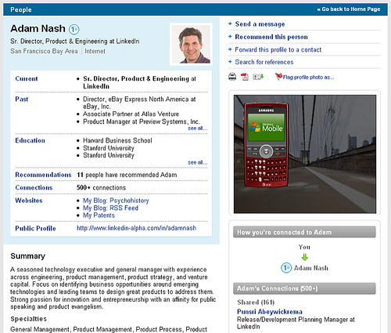
Sample Linked-In Profile

Slide 15
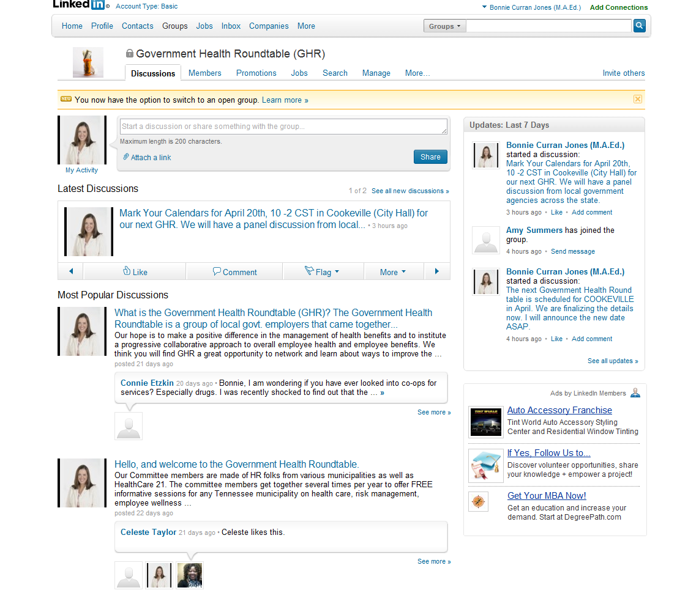
Groups

Slide 16
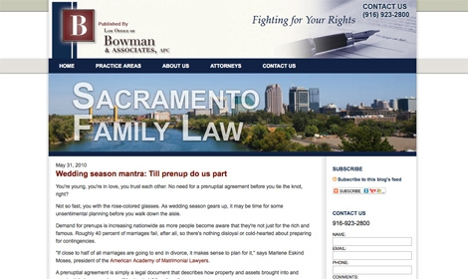
BLOG
A blog is a journal that is available on the web. The activity of updating a blog is “blogging” and someone who keeps a blog is a “blogger.
Notes:
A blog is normally a single page of entries. There may be archives of older entries, but the "main page" of a blog is all anyone really cares about.
A blog is organized in reverse-chronological order, from most recent entry to least recent.
A blog is normally public -- the whole world can see it.
The entries in a blog usually come from a single author.
The entries in a blog are usually stream-of-consciousness. There is no particular order to them. For example, if I see a good link, I can throw it in my blog. The tools that most bloggers use make it incredibly easy to add entries to a blog any time they feel like it.

Slide 17

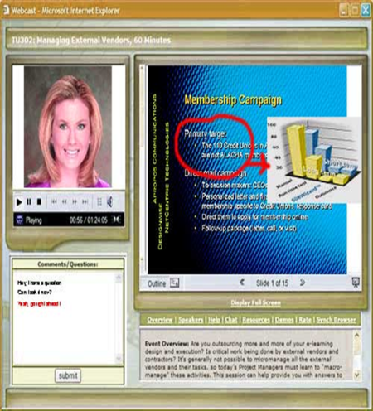
PODCAST & WEBINARS
A podcast is a pre-recorded audio program that is posted to a website and is made available for download so people can listen to them on iPods, computers or mobile devices. Podcast gets its name from Apple’s iPod.
Webinar is a Web-based seminar, a presentation, lecture, workshop or seminar that is transmitted over the Web.
Notes:
Podcasting takes its name from Apple's popular iPod line of products, but it isn't limited only to iPod owners and listeners. What distinguishes a podcast from other types of audio products on the internet is that a podcaster can solicit subscriptions from listeners, so that when new podcasts are released, they can automatically be delivered, or fed, to a subscriber's computer or mobile device. Usually, the podcast features an audio show with new episodes that are fed to your computer either sporadically or at planned intervals, such as daily or weekly. Just like the old radio serials of the 1930s and 40s, this format encourages listeners to subscribe so they can find out "what happens next."
Webinars and Podcasts are Top business resources for businesses
Training and lectures
Meetings
OCS- (UT)
http://www.webopedia.com/search/Podcasts

Slide 18

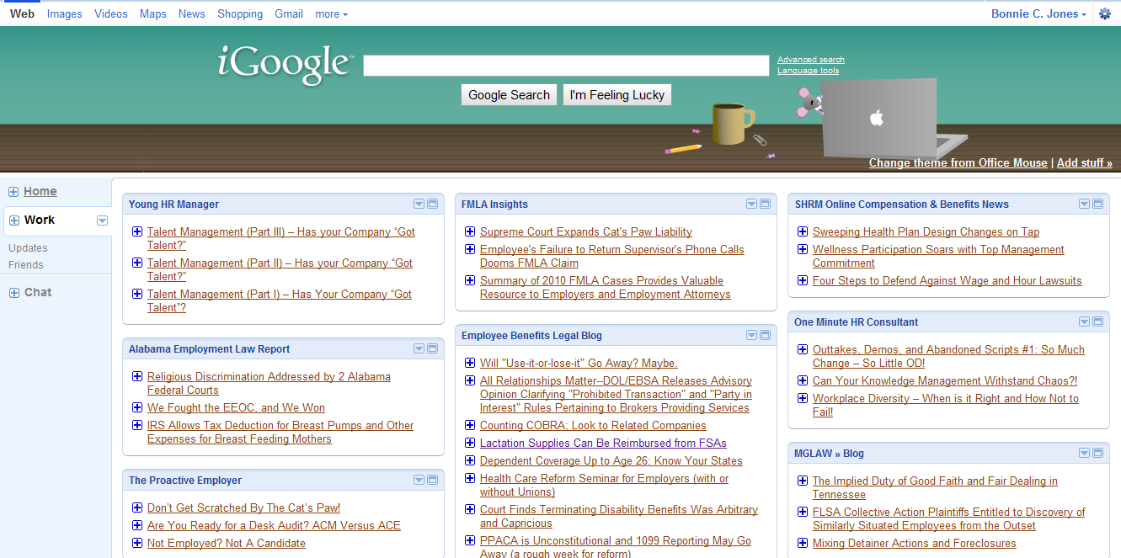
RSS FEEDS
Notes:
RSS is a technology that is being used by millions of web users around the world to keep track of their favorite websites.
In the ‘old days’ of the web to keep track of updates on a website you had to ‘bookmark’ websites in your browser and manually return to them on a regular basis to see what had been added.
Who knows what RSS stands for?
REALLY SIMPLE SYNDICATION
It is the new way to bookmark information!
What is RSS?
RSS is a technology that is being used by millions of web users around the world to keep track of their favorite websites.
In the ‘old days’ of the web to keep track of updates on a website you had to ‘bookmark’ websites in your browser and manually return to them on a regular basis to see what had been added.
The problems with bookmarking
You as the web surfer had to do all the work
It can get complicated when you are trying to track many websites at once
You miss information when you forget to check your bookmarks
You end up seeing the same information over and over again on sites that don’t update very often
RSS Changes Everything
What if you could tell a website to let you know every time that they update? In a sense, this is what RSS does for you.
RSS flips things around a little and is a technology that provides you with a method of getting relevant and up to date information sent to you for you to read in your own time. It saves you time and helps you to get the information you want quickly after it was published.
RSS stands for ‘Really Simple Syndication’. Many people describe it as a ‘news feed’ that you subscribe to.
I find the ‘subscription’ description helpful. It’s like subscribing to a magazine that is delivered to you periodically but instead of it coming in your physical mail box each month when the magazine is published it is delivered to your ‘RSS Reader’ every time your favorite website updates.
o you want to use the Google Reader? This is an online RSS reader. You can sign up for many different RSS feeds and get them all on this page. Bookmark the page and you can go to it whenever you want. This is formatted more like an email program. As you read the messages they will be marked as read.To add it to your Google Reader click on the "Add to Google Reader" button. Bookmark the page so you can find it again.

Slide 19
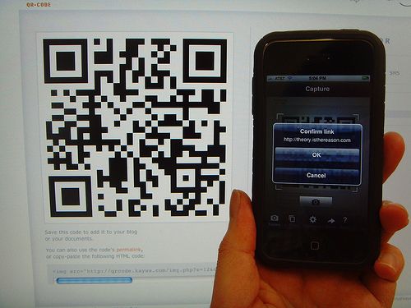
QR Codes
A QR code is a two-dimensional bar code that appears as a black and white pattern that can be scanned using your camera phone or a QR reader
Requires less effort and is more specific than typing/ remembering aURL
The QR code automates and stores information
Using smartphones or software you can get lots of specific information quickly
Can be added to products, websites, business cards, printed media, coupons, etc.
Notes:
Ever lose a business card? Or a Coupon? Or perhaps you find an old business card but aren’t sure if the person works there anymore.
A QR code is a two-dimensional bar code that appears as a black and white pattern. There is encoded data on the code, similar to the bar codes that you may see in retail stores, yet these codes often appear on websites and the encoded data is usually a URL, geo coordinates or other computer-related information that is intended to be decoded quickly by a special bar code reader. The term “QR” is short for “quick response.” You can easily create QR codes that serve as hyperlinks to mobile content. In many parts of the world the scanning of a QR Code has become the door to the mobile Internet for the average mobile use.
Anyone with a smartphone can scan and read QR codes with the click of a camera, and anyone with access to a computer can generate QR codes themselves. BayBrain’s Snappr.net offers a QR bar code generator and links to a comprehensive list of software for code reading. By scanning the codes, you can access images, websites and text. By creating the codes, you can produce your own messages.
Usually synonymous with mass production, the quick response (QR) bar code was originally created by Japanese company Denso-Wave to keep inventory. However, because QR codes allow for more data than the standard 10-digit bar code, and because scanning requires less effort than typing a URL, the QR has taken a turn for the personal. The genius behind QR codes is that even a hairless chimp can play with them. Below are five of my favorite uses: This summer Eventbrite, tested a QR code program for concert and party registration. Meant to increase efficiency and reduce waste, this type of registration will likely become more popular as camera and scanner technology improves. In the future, codes could be used to signify race checkpoints with sports fans tracking their favorite cyclists and motorists in real time from their phones.
There are several uses for QR codes when it comes to your website. Having a system in place that can automatically generate a QR code for every product on your site makes it easier for your customers to contact you, return for the exact item they were considering, or share with friends. Adding QR codes to any printed media that you use, such as flyers, posters or business cards will allow you to code multiple pieces of information instantly, including details about products, contact information for your business, special offers, coupons or links to your site
QR codes can automate and store a tremendous amount of information and allow users to quickly access this information. Using software on a cell phone or computer, users can get information from QR codes instantly.
There are several software programs that allow you to create your very own QR codes pretty easily. Try one of the most common ones, such as Kaywa, iCandy, or StickyBits to get you started with using QR codes for your business. These programs are pretty user friendly and will walk you through the development and implementation of your own QR codes, helping you to individualize the codes and include the most relevant information for your purposes.

Slide 20

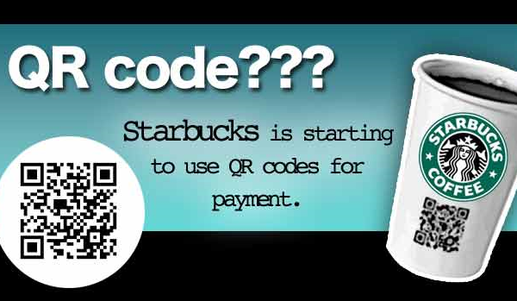
The new name badge/ business cards
A virtual business card- never needs to be updated or re-printed
Scan someone’s code and you can virtually keep up with them via social networks, events, and as a contact
You can have one for you personally and for your business / city
Contact information can be downloaded just by scanning the bar code
Could replace airplane tickets, business cards, name badges, donation forms, print media, and be used as a payment method
Notes:
Everywhere you look at the South by Southwest conference this week, you see QR codes. The square "quick response" codes turn URLs, vCards, or any kind of text into a jumble of pixels that you can scan onto your smartphone instantaneously, no typing required. At SXSW, QR codes appeared on flyers, postcards, business cards, t-shirts, stickers, and swag. Organizers of the Austin gathering for film, music, and Web geeks even included a QR code on every registrant's badge to cut down on paper waste and manual data entry.
The SXSW site explains:
When you meet someone at an event, let them scan your badge with their smart phone, and they will automatically be following you on [the conference's social network] my.SXSW, where they can message you or access your contact information. Hopefully, this will cut down on the paper footprint of SXSW by reducing the need for business cards.From there you can export all your SXSW contacts to your address book, email, or contacts application of choice.
PortaPayments is a brilliant little idea: it's an Android app that creates QR codes for PayPal payments. Scanning one of these QR codes takes you to PayPal with the recipient and amount all filled out. Manually approve the payment and you're done.
This enables mobile payments (create the code on your phone and the customer scans it with their phone) as well as allowing you to use the QR code images as, say, a tip jar on a website, or printed on an invoice. Lots of possibilities: I can imagine a charity printing up posters or handbills that include PortaPayment codes so people can easily make a donation.
One hitch I found in testing the app is that the PortaPayments app must be used to scan the codes;other barcode scanners will not work correctly. If the developer can address this issue, businesses would be more apt to use it.

Slide 21
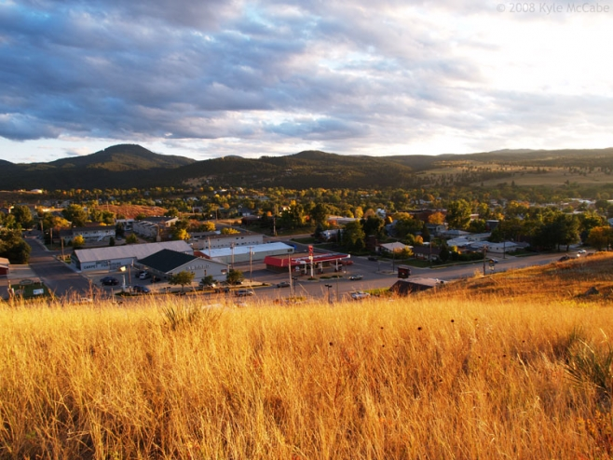
City of Manor, Texas:
Pop 6,500
Using QR codes to improve operations at city hall
Residents scan in QR codes around town to access schedule of events, rules, and projects
City uses a website that invites residents to suggest and vote on proposals for improving services
Citizens are rewarded for helping create a more efficient city with “innobucks” which can be redeemed for prizes or re-invested to make ideas come to fruition
http://cityofmanor.org/wordpress/labs/qr-codes-2/
Notes:
hat said, there are examples of smaller cities that are using new media to improve operations in city hall. One shining example is the City of Manor, Texas. With a population of only 6,500 and a municipal staff of 35 employees, this community, located just east of Austin, has set itself up as a laboratory for innovation. One visible example of the community’s willingness to experiment with technology is its deployment of two-dimensional barcodes (known as QR Codes) around town. Using the technology, residents can use their mobile phones to scan a code (say on a sign posted at a city park), and then be taken to an up-to-date web page with information about, say, schedule events and park rules and regulations.
To engage its citizens even more, the City launched Manor Labs, an interactive website that invites residents to suggest and vote on proposals for improving services. What separates Manor Labs from other crowd sourcing efforts is the City’s creative way of incentivizing participation. Each time a resident participates online – either by suggesting a new idea or commenting and voting on the ideas of others – they receive a point, called an “innobuck.” Innobucks can be redeemed for prizes, or re-invested towards making some of the ideas on the site a reality. Once an idea reaches a certain threshold, city officials evaluate the proposal, and decided whether or not to put it into action. So far, five ideas have been adopted from the site.
Of course, it’s not reasonable (or even desirable) to have every town follow Manor’s example. Instead, more focus should be placed on helping smaller cities and towns partner with each other (and with larger cities) to develop standards and tools that will allow all sizes of municipal government to benefit from new media – without having to reinvent the wheel themselves.
Open311 is one such effort. Lead by The Open Planning Project, a New York City based non-profit that focuses on community driven initiatives and open technology, Open311 is a collaborative project that aims to create an open platform specification for 311 services – which cities could adopt to ensure interoperability between their current 311 systems. With such a standard in place, it’s likely that a host of solutions for both cities and residents would emerge – saving cities without web enabled 311 systems the trouble of developing them on their own.
Other efforts at creating standards are being cataloged at OpenMuni.org, a website dedicated to sharing best practices for implementing new technology between cities (also supported by the Open Planning Project). The next step might be to bring cities together to support the development of a platform and applications that they can all adopt, sharing the costs associated with deploying new media tools. Yet however they progress, one thing is for certain. As more of these civic data and application specifications are established, residents in places like Little Rock, Arkansas and Bend, Oregon will have just as much benefit from new media tools as people living San Francisco and Chicago.

Slide 22

Let’s think about Social Media & the hiring process
Job Announcements
Networking
Sharing information
Applications and Resumes
Hiring procedures
Background checks
Informal “web” searches

Slide 23
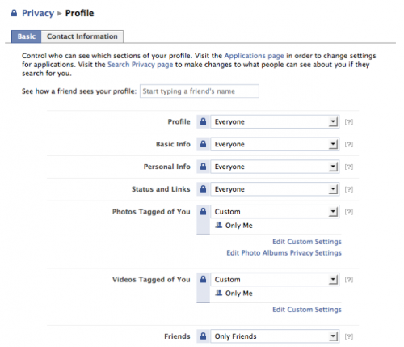
Privacy settings
Notes:
Remember that time in Mexico?
This is the number one most common theme I hear among more traditional folks – “If you don’t want it out there, don’t put it out there.” or “Adjust your privacy settings.” Sounds pretty simple right?
Tech experts generally believe that today’s tech‐savvy young people
– the ‘digital natives’ who are known for enthusiastically embracing
social networking – will retain their willingness to share personal
information online even as they get older and take on more
responsibilities. Experts surveyed say that the advantages
Millennials see in personal disclosure will outweigh their concerns
about their privacy.
Janna Quitney Anderson, Elon University
Lee Rainie, Pew Research Center’s Internet & American Life Project
July 9, 2010

Slide 24
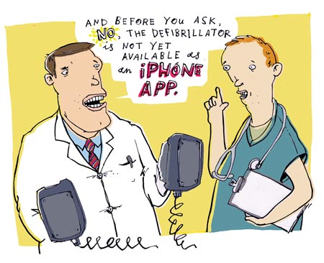
Privacy settings don’t:
Protect from impersonation
Protect from harassment
Protect from fraud
Control what other people may post
Regulate tagging pictures
Account for generational differences
Account for technological aptitudes
Notes:
One of the most common things people say is, If you don’t want something out there, don’t put it out there for the world to see. The good news is there are privacy settings on these profiles. The bad news is, that doesn’t stop people from impersonating you or creating fake profiles to harass you.
Or anything else that someone else creates, modifies, or displays with your name on it
Scanning old photos in?–
Remember that time 20 years ago! Arghhh….
Remember that vacation in Mexico?
Tagging pics that are not you (can be done as a joke)

Slide 25
Employers use social media to hire & fire
83% of employers will Google search candidates
77% uncover information online on applicants
75% of recruiters use a web tool
85% of employers say a positive online reputation influences their hiring decision
Notes:
Stats on slide are from msnbc article called MSNBC misunderstands role of social media by Pete Kistler and site the following: 2008/2009 studies from careerbuilder and Execunet

Slide 26

Why is this so enticing?
“Social networking sites hold out the promise of revealing the “real applicant.”
“ Standard reference checks just aren’t cutting it. Prior employers will only disclose dates of employment making it hard to determine reliability and personality issues.”
“Resumes and interviews only tell a part of the story. I have made some hiring mistakes in the past and I want to try to avoid those in the future.”
Notes:
Many companies are using social networking sites to hire and recruit new talent. Organizations can create profiles and post open positions. If recruiters create their own profiles, job seekers can “friend” them or become connected allowing recruiters to in turn review their information and profile. Recruiters can them search and view the profiles of anyone who becomes a “fan” of their company page.
Recruiters can conduct detailed searches of their friends or they can perform a general search of facebook members which will produce a list of people and groups associated with the search terms. Recruiters can then join these groups or ask these individuals to be added as a friend for further access to their profile information. Recruiters can also invite people to a Facebook event (an online career fair) or suggest they become a fan of the company page to learn more about their organization.

Slide 27

So, what is the big deal anyway?
Notes:
So, what is the big deal anyway? Why should employers be concerned about use of social media and employment relationships?

Slide 28
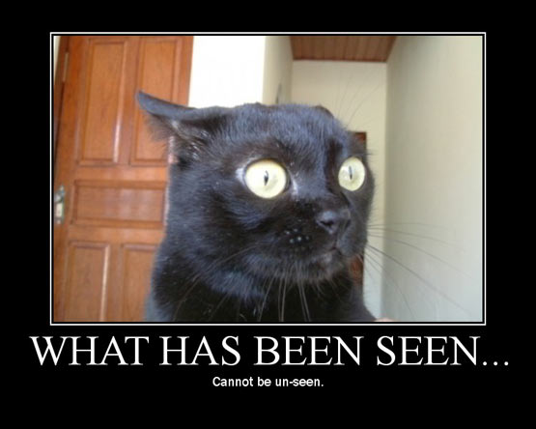
+
Notes:
You cannot un-ring the bell. Period.

Slide 29


What can be seen on profiles?
Religion
Relationship status
Sexual Orientation
Veteran Status
Disability Status
Ethnicity
Race
Gender
Age
Location (Hometown & neighborhoods)
Health Status/ Family Health Status/ Health interests
Notes:
What is wrong with an employer seeing this information?
It is a violation of law to use this information in the hiring process or to discriminate against someone in a protected class. Additionally, things like childhood neighborhood and residence could elude to your likely ethnicity and or race.
Ethnicity is not just a person’s race. We can say that a Caucasian is white, but that doesn’t describe his ethnicity. If we lined up a Caucasian from Ireland, Israel and Canada in a photograph, it would be difficult to discern from which country each person originates. Yet, if we gave them appropriate items from their culture, it becomes easier to determine their country of origin. Ethnicity is about tradition, learned behavior and customs. It is about learning where you come from, and celebrating the traditions and ideas that are part of that region.
Read more: Difference Between Ethnicity and Race | Difference Between | Ethnicity vs Race http://www.differencebetween.net/science/nature/difference-between-ethnicity-and-race/#ixzz15O11O0Nt

Slide 30

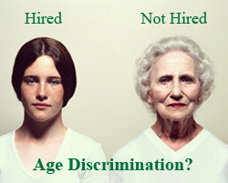

Legal Considerations
USERRA / State Military Laws
TITLE VII
ADA
ADEA
PDA
GINA
Disparate Impact
Disparate Treatment
Notes:
Most social networking sites show an employer a person’s gender, race, age, sexual orientation, neighborhood, family members, religious views, family status, pregnancy status, and political views. In some cases a person’s profile may yield direct or indirect information about medical information, genetic issues, and health status. If an employer has access to this information, how can they guarantee they won’t use any of this information to make hiring or employment decisions? Once the information is viewed, there is no way to go back and undo what the employer has learned. This is perhaps, the largest employment risk associated with reviewing online profiles on candidates.
Potential liability arises when an employer uses the information found via social media affect hiring and or employment decisions. For example, an employer is getting ready to make Sarah an offer, and suddenly finds Sarah’s online profile and clearly sees she is pregnant. The employer may change the hiring decision based on the online information, which is illegal. In addition, the employer may have been able to determine Sarah’s relative age, marital status, race and even religious and political affiliation. Employers making employment decisions based on information related to protected classes may be a violation of state, local, and federal laws.
Another particular risk for employers exists in the form of disparate impact claims if it was found that applicants who had a certain protected characteristic (i.e., race) in common were being systematically refused employment. Even if there is no disparate impact based on actual viewing of the profiles, there may be a disparate impact if the company tended to hire those who had social networking profiles rather than those who did not. This could occur because (while this is a generalization) social networks are comprised of younger, more affluent (i.e.,those sophisticated with the use of the Internet) users.
There are some companies offering to do screening assistance with removal of any protected status information.

Slide 31

GINA rules just released
Genetic Information Nondiscrimination Act (GINA)
Legislation that prohibits employers from using genetic information to make employment & health insurance decisions.
Initial language made simply viewing the information illegal
Final regulations provide clarification and exceptions, however;
It is illegal to acquire or use genetic health information when that information was not intended for the employer to see
It is illegal to make employment and health insurance decisions based on genetic information
The bottom line, be careful about any employment practice that could allow your city to view or acquire any genetic information on applicants, employees and their family members.
Notes:
The Issue: Acquiring Employee Genetic Information Via Social Media = Violation?
Recall that GINA makes the mere acquisition of genetic information illegal, and the Act broadly defines “genetic information” to include even medical conditions of family members. This left employers wondering if they’d be facing a GINA violation if, for example, a supervisor found an employee’s status update saying he was raising money for multiple sclerosis in honor of his father who is suffering for it. Employers wondered if just receiving that information might be a violation.
Some acquisitions of genetic information aren’t illegal; the law provides specific exceptions. The final regulations now clarify the scope of those exceptions regarding acquisition of genetic information through social networking or social media sites such as Facebook.
Most notably, if an employer obtains genetic information through a social media site or publicly available media sources, it is not protected by the commercial exemption if the employer sought out the information with intent of obtaining genetic information or if the employer is “likely” to acquire genetic information by accessing those media sources.
Genetic Information Nondiscrimination Act (GINA): This legislation prohibits employers from using individuals' genetic information when making hiring, firing, job placement, or promotion decisions. This legislation also prohibits improper use of genetic information for purposes of health insurance and employment decisions. GINA broadly defined genetic information to include family members of employees which initially left employers concerned about the implications of using social media to interact with employees. On November 9, 2010 the EEOC released final Regulations which address treatment of acquiring genetic information via social media. For example, under the Inadvertent Acquisition Exception, an employer would likely not be in violation of GINA if they came across an employee’s genetic information that was available on a social media site for which they were given permission to access by the creator of the profile (i.e., the supervisor is friends with the employee on Facebook). However, in situations that require social media users restricted access or access by invitation only these sources of information will not be covered under the “Commercially & Publicly Available Exception.” This means, an employer cannot acquire genetic information when that information is not intended to be available to them (i.e., through privacy settings or special group access). Most notably, if an employer obtains genetic information through a social media site or publicly available media sources, it is not protected by the commercial exemption if the employer sought out the information with intent of obtaining genetic information or if the employer is “likely” to acquire genetic information by accessing those media sources.
The bottom line, be careful about any employment practices that could allow your city to view or acquire any genetic information on applicants, employees and their family members. Never make a hiring or employment decision based on genetic health information, this is illegal.
The final regulations can be found at http://www.eeoc.gov/laws/types/genetic.cfm

Slide 32
Disparate impact claims
An April 2010 chart at Mashable.com shows that the populations on Facebook are not equivalent to those in the general US population.
There are proportionately more Asians, Blacks, and Latinos on Facebook than in the general population, but fewer Whites.
If 70% of recruiters are rejecting candidates based on social media this could lead to minorities being more negatively affected by the use of social media in the recruitment process.
Notes:
Disparate Treatment Claims
When applicants fill out job applications, they are not (supposed to be) asked questions that might reveal their age, religious views, familial or marital status, sexual orientation, etc.; however, people who maintain Facebook or LinkedIn profiles typically post a photo, and may disclose information about their family or marital status, religious views, sex, age, birthdate, race, ethnicity, etc. (to potential employers).
Further, disparate treatment claims could arise when a recruiter checks out social media information for some applicants but not others, or if the recruiter evaluates data in different ways for different applicants.
Disparate Impact Claims
A disparate impact claim may arise if the recruiter relies exclusively on social media to search for job candidates. For example, if only candidates who maintain a social media profile are considered, this will automatically screen out a large pool of the civilian labor population that does not maintain such profiles.
Whites and Asians are clearly over-represented on Facebook and LinkedIn in comparison to the civilian labor force. She provides additional statistics on African-Americans and Hispanics.
Finally, the male/female split for the Facebook population is approximately 43% male, 57% female, while the general U.S. population is approximately 48% male, 52% female. Again, if employers are searching Facebook and using information found there to disqualify applicants, this procedure could have a disparate impact on females given the fact that a greater number of females are on Facebook than are in the general population

Slide 33

Therein lies the problem
While an employer simply viewing an applicant’s information may not inherently lead to discrimination, employers who make adverse employment decisions and have also viewed the applicant's social networking profile – (whether or not they factored in any information) - may find themselves subject to a discrimination claim.
Are you prepared to defend a claim?
Notes:
Can you prove you didn’t use that information to make a hiring decision?

Slide 34

Reasons why candidates are not hired
35% of employers surveyed found content that caused them NOT to hire someone for:
Inappropriate photos
Poor communication skills
Questionable judgment
Lack of professionalism
Dishonesty (credentials)
Badmouthing employers
Notes:
Once the employer views the individual's social networking page, there is no going back. Both Facebook and MySpace provide user profile pictures that could automatically provide the employer with information concerning race, gender and age. Because users of these sites typically provide additional information about themselves, including their interests, there is a danger that you could become aware they are disabled, work in the military, have a family, etc. While the availability of this information does not inherently lead to discrimination, employers that make adverse employment decisions and have viewed an applicant's social networking profile - whether or not they factored in any information - may find themselves subject to a discrimination claim.

Slide 35

On the flip side
18% of employers say the information encouraged
them to hire someone.
Profile provided a good feel for personality and fit (50%)
Profile supported resume info (39%)
Candidate was creative (38%)
Candidate showed good communication skills (35%)
Candidate was well-rounded (33%)
Other people posted good references (19%)
Candidate received awards and accolades (15%)
Notes:
Source: Oregon Biz Report August 24, 2009
www.oregonbusinessreport.com
And CareerBuilder.com

Slide 36

Expectation of privacy
If profile is set to private, there is a reasonable expectation of privacy
Courts are not tolerant of an employer spying on employees and or breaking terms of use and illegally or unethically obtaining information
First Amendment provides freedom of speech
Higher expectation with younger workers
Generation Y outnumbers Boomers by 1.3 M- they do not know a life without social media and they are the face of the next line of managers
Notes:
Even though they communicate and share photos in a forum that can be public, there is sense that what goes on in MySpace or Facebook stays there and should stay there. This argument is buttressed by the fact that in order to enter some social networking sites, a user must agree to “terms of use” and to get details of another site member, the new user must set up their own account. Additionally, these types of websites have “terms of use” typically do not allow “commercial” uses, which can include screening candidates. Since a user must jump through some hoops, it can be argued that there is an expectation that the whole world won’t be privy to confidential information.
The first step in managing Gen Y is understanding who they are. According to the Census Bureau, Gen Y are those born between 1977 and 1995. Outnumbering the baby-boomer generation by 1.3 million, Gen Y will have a dramatic social impact and economic impact on the business world.

Slide 37
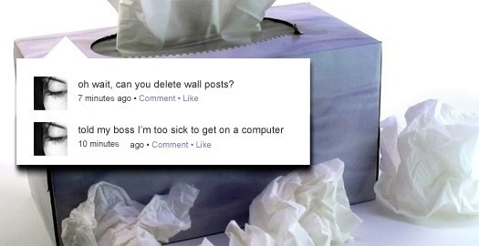

Disciplining employees for social media use
On the clock or off?
Employment related?
Fact or Fiction
Policy violation?
Legal violation?
How did employer obtain the
information?
Workers’ Compensation
Notes:
Off-duty conduct is another tricky area. Some states have prohibitions limiting use of private behavior for employment decisions. However, employers do have broader discretion if such behavior would damage a company, hurt business interests, or be inconsistent with business needs.

Slide 38

Bozeman, Montana
The city started requiring applicants to submit a list social networking User names and Passwords so they could conduct a background check.
Dangerous practice. Don’t do it.
Never try to obtain access through
a backdoor or by setting up a fake
profile.
Notes:
Violation of 4th Amendment Rights
Invasion of constitutional right to privacy
Against facebook and other usage policies
This happened recently with several public service positions in various cities!

Slide 39

Best practices
Create social media policy
Be aware of recordkeeping requirements
Be consistent
Provide a disclaimer with applications
Have the non decision maker use social media to
screen candidates
Be honest about why someone was not hired
Use a well balanced approach to screening
Don’t rely on social media as sole recruiting source
Notes:
*Add photos of accidents and incidents in your policy.
What are some “best practices” for hiring managers who are using social media sites to screen applicants?
A. Consistency is the key for hiring managers who use social media sites to screen job applicants. Employers become vulnerable if they are selective in picking which applicants to screen online, or if they evaluate differently the information found on certain applicants.
When employers are exposed to an applicant’s protected or personal information, they must show that it did not influence their decision. To avoid costly refusal-to-hire claims, an employer that screens through social networking sites should have a non-decision maker undertake such background checks.
While reviewing the content, only job-related criteria should be considered. Documentation is critical. Hiring managers should maintain records of the social networking tools used, their findings and explanations of why an applicant was or was not considered or chosen for a particular job.
This article was provided by the Ohio State Bar Association and prepared by John W. McKenzie, a shareholder with the Akron labor and employment law firm Kastner Westman & Wilkins, LLC, which represents management exclusively.

Slide 40

If you use social media to screen applicants have a policy that:
Defines what positions and departments this will cover
Defines what the employer will be looking for
Defines what will not influence the hiring decision
Creates a consistent standardized process
Defines what technology and websites are included in practice
Defines recordkeeping requirements
Provide this policy to applicants upfront.
Notes:
Define who: All positions? Certain departments? Etc.
Define when: At what point does human resources look to online resources?
Define what: What is the employer looking for (and what will not influence its hiring decision)? Which technologies or websites are covered?
Define how: Create a standardized process, identify objective considerations, and describe applicable limits.

